Slide 1

Reinforcement Learning Upside Down : Don’t Predict Rewards – Just Map Them to Actions
+ Training Agents using Upside-Down Reinforcement Learning
By Juergen Schmidhuber, Rupesh Kumar Srivastava, Pranav Shyam, Filipe Mutz, Wojciech Jaskowski
Aug 8, 2023
Sungmin Yoon

Slide 2
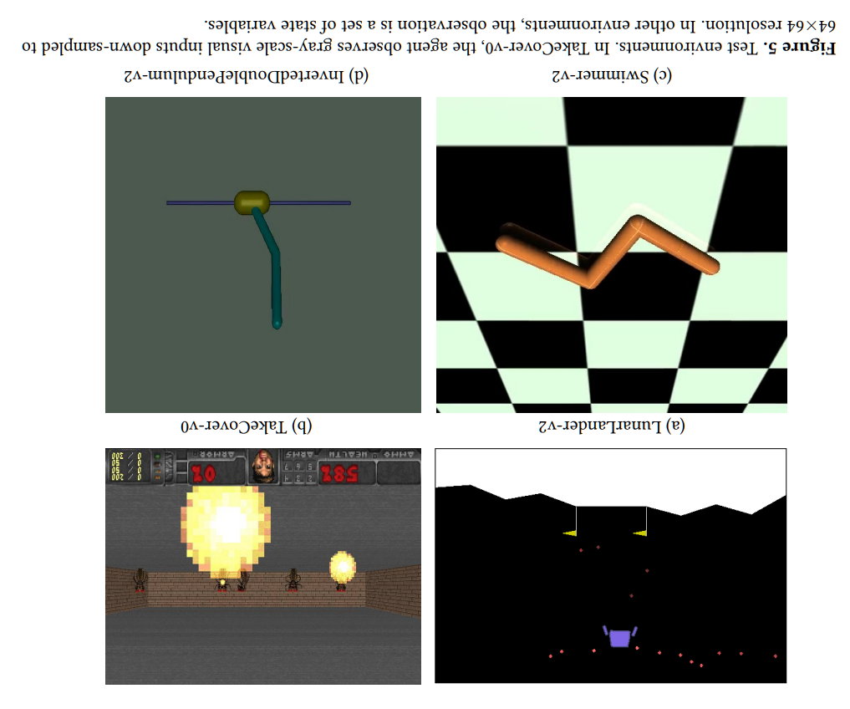
Index
Background : RL vs SL
Concept of
Experiment & Result
Discussion
RL

Slide 3
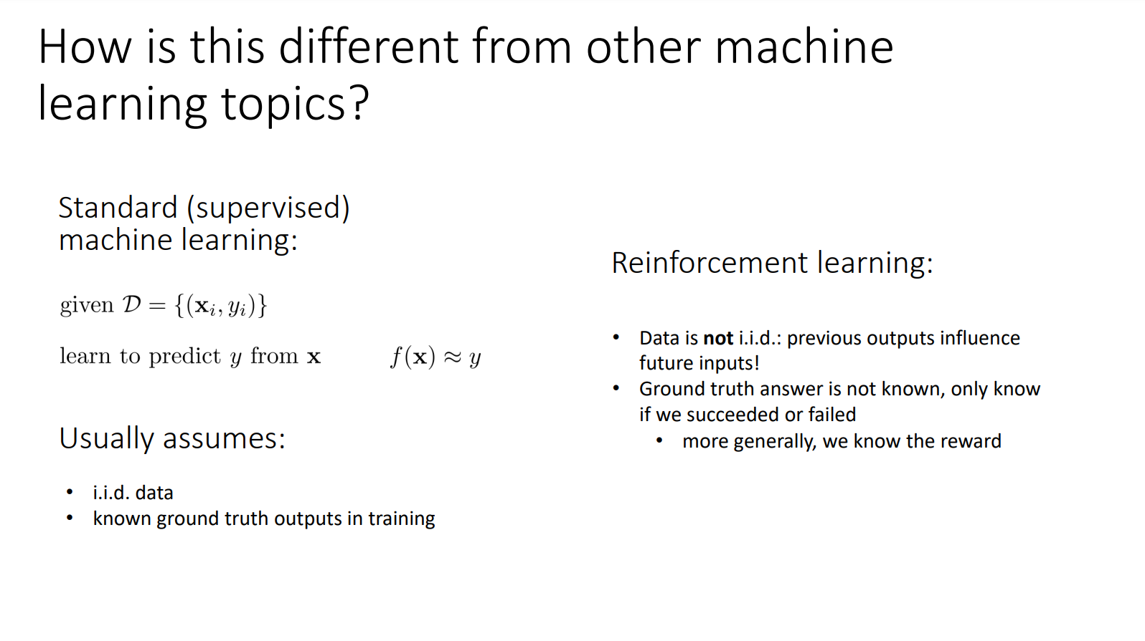
RL vs SL
Different Data’s characteristic
(Slide From CS285 (Sergey Levine) Lecture : https://rail.eecs.berkeley.edu/deeprlcourse-fa21/)
Q1. What about Sequence data?
My thought : There’s still difference (causality)
Notes:
Independent and identically distribution
The relationship between cause and effect

Slide 4
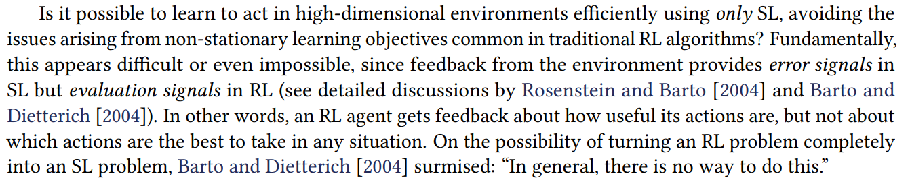
RL vs SL
Different Data’s characteristic
Reason to shift RL into SL
Introduction of RL Upside Down

Slide 5
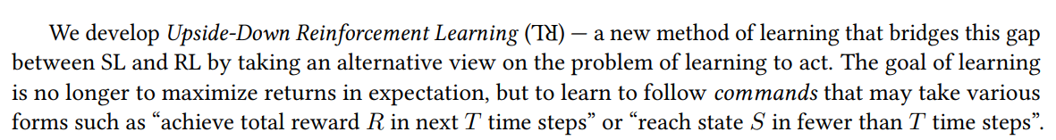
RL → SL
Trick : Command (Optimization Problem → Decision Problem like NP)

Slide 6
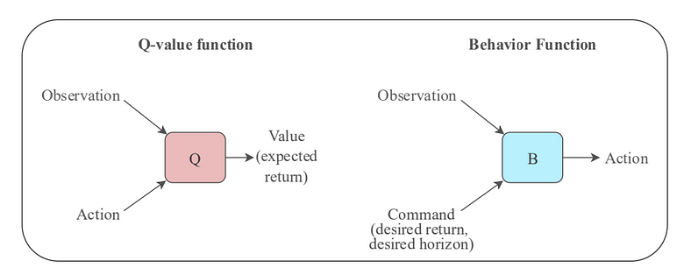
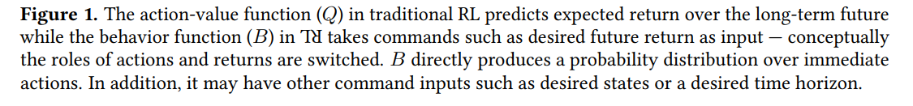
Concept of
RL
S → A → R → S → A …
S → R → A → S → R …

Slide 7
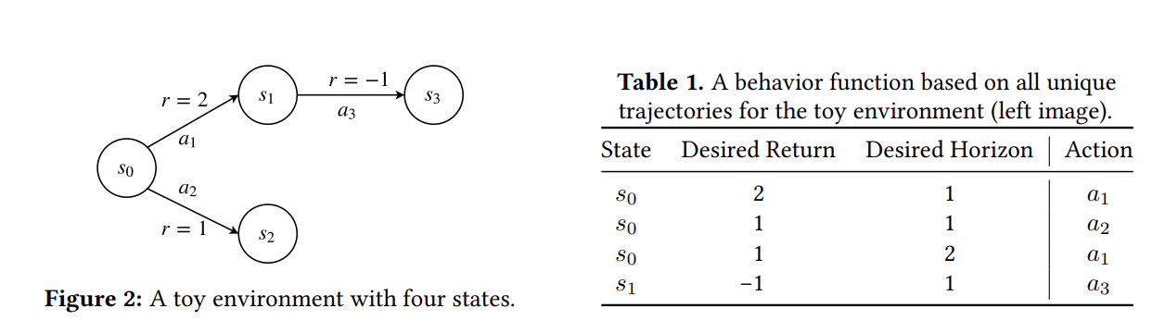
Concept of
RL

Slide 8
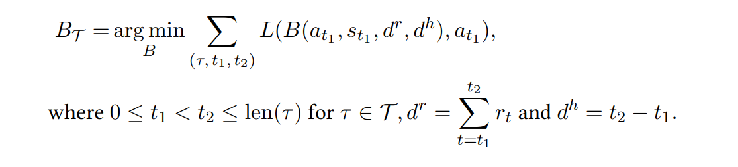
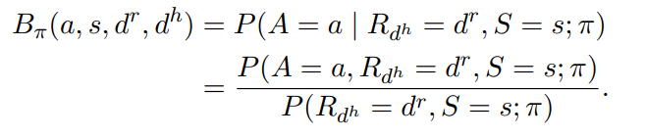
Notation of
RL
Desired Return
Desired Horizon
Trajectory

Slide 9
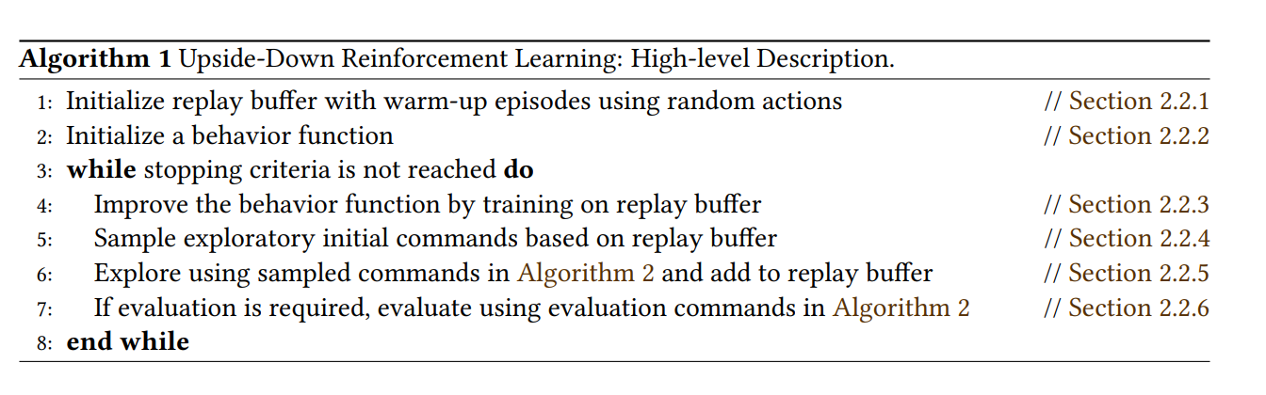
Concept of
RL

Slide 10
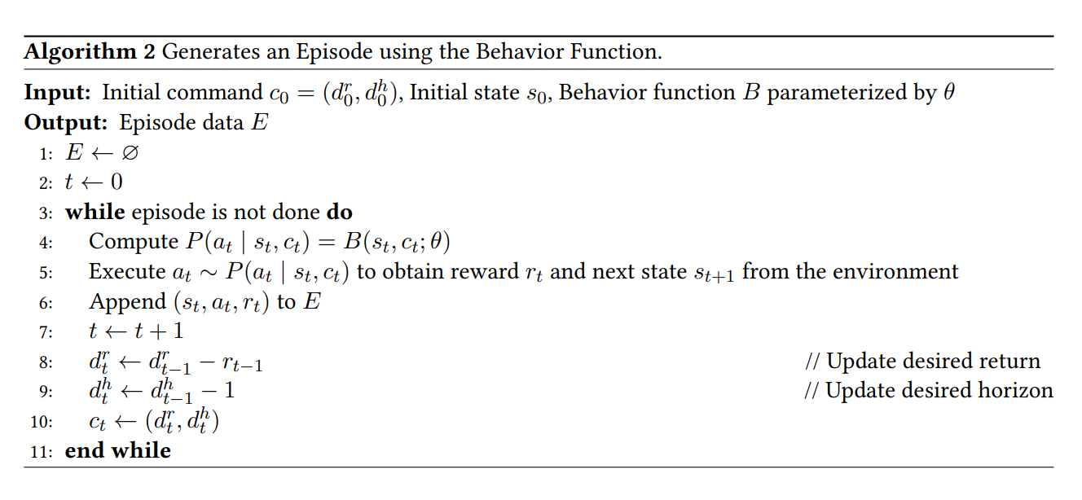
Concept of
RL

Slide 11
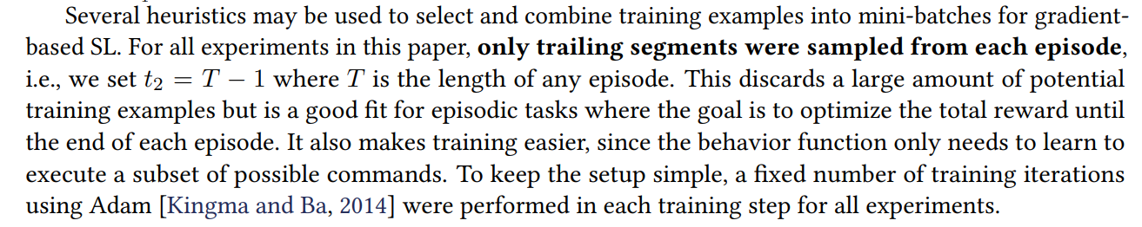
Concept of : Detail
RL
Training the Behavior Function B

Slide 12
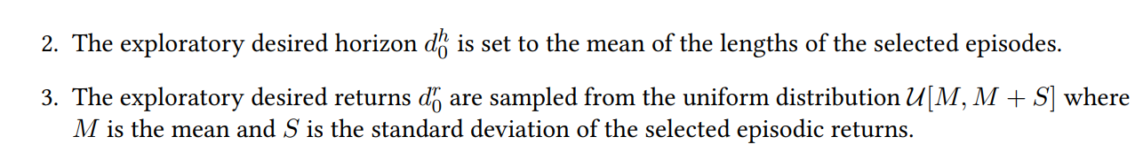
Concept of : Detail
RL
Sampling Exploratory Commands

Slide 13
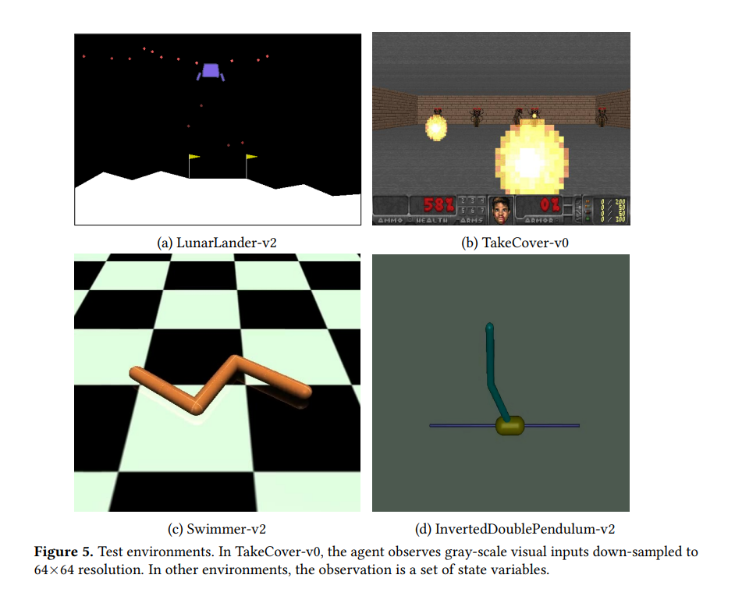
Experiment

Slide 14
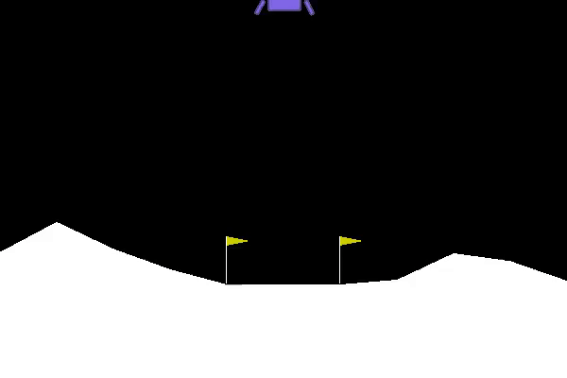
Experiment
Before Training

Slide 15
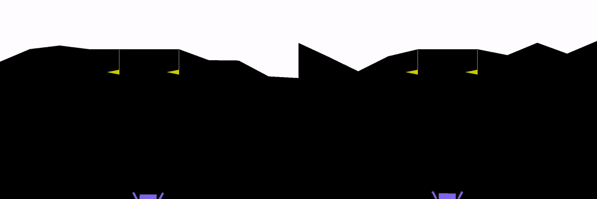
Experiment
After Training

Slide 16
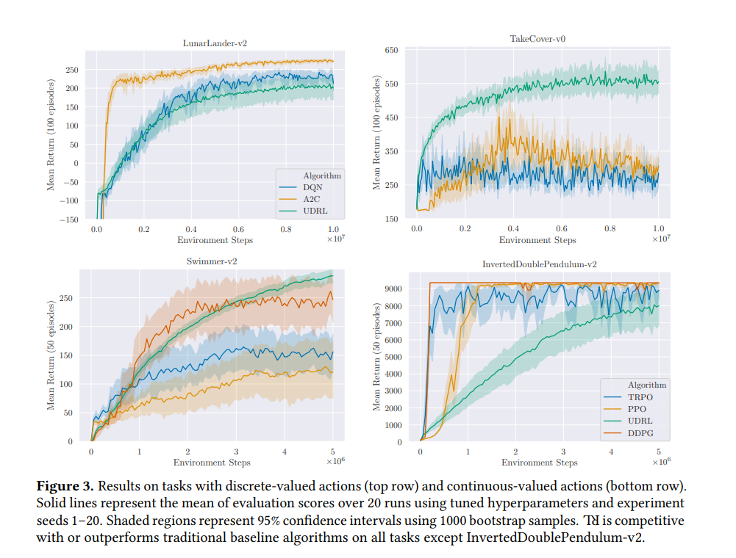
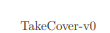
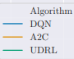
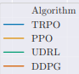
Result
Discrete-valued actions
Fluctuating!
Multi-step returns
Continuous-valued actions
unstable
Poor performance…
But it work better in challenging environment
Notes:
Lunar Lander는 sequential한 특징이 강함.

Slide 17
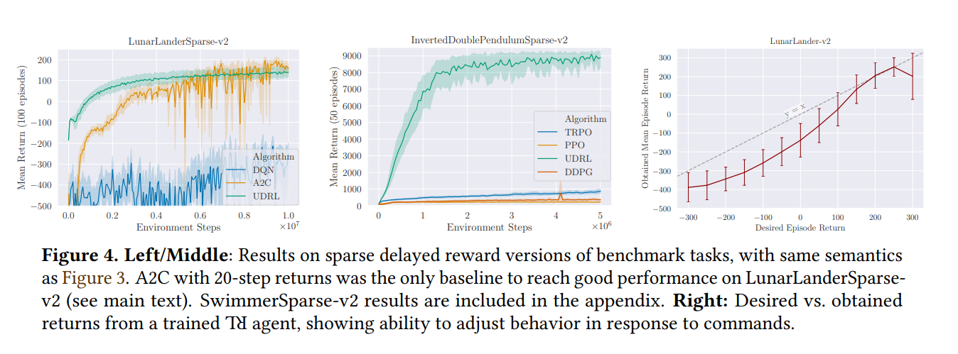
Result
Notes:
Lunar Lander는 sequential한 특징이 강함.

Slide 18
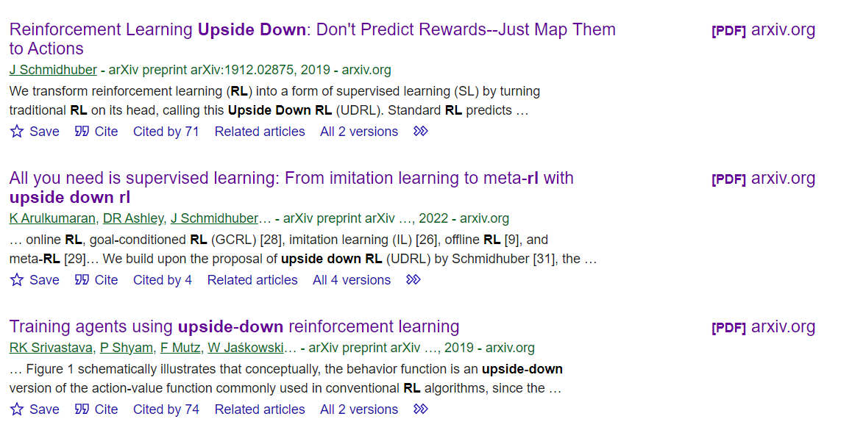
Discussion : Why are these paper’s citation so low?
Famous and powerful author in this field.
Novelty : interesting
Bridge between SL and RL
Good performance

Slide 19
Discussion : Future work
Notes:
아래 두 개는 sergey levine

Slide 20
Discussion : Further readings
All You Need Is Supervised Learning : From Imitation Learning to Meta-RL With Upside Down RL
Decision Transformer: Reinforcement Learning via Sequence Modeling
Diversity Is All You Need : Learning Skills Without A Reward Function
Offline Reinforcement Learning : Tutorial, Review, and Perspectives on Open Problem
Notes:
아래 두 개는 sergey levine

